Slide 1


Welcome!
Train disinfecting,
protect health.
Powered by:

Slide 2
FOR HYGIENE OFFICERS
This presentation is available for free use in hygiene training sessions with DesiCoach®. It can be adapted or expanded as needed. For example, you can integrate only the practical training part into your own presentation. It's entirely flexible to fit your framework.
License Terms
Please note that the images and graphics contained in this presentation are subject to specific licensing conditions. They may be used exclusively for presentation purposes within the context of hygiene training.
Sharing the images in their original form or using them for other purposes (e.g., for online marketing, print media, or other commercial and distribution products) is not permitted.
For further information and questions about the presentation or DesiCoach®, please feel free to email us at hey@heyfair.de.
Preface to the presentation
www.heyfair.de

Slide 3



01 | LEARNING OBJECTIVES
Identify and avoid mistakes
These are our topics
02 | NECESSARY SITUATIONS
The 5 moments of hand disinfection
03 | TRAINING
Practical training in hand disinfection

Slide 4
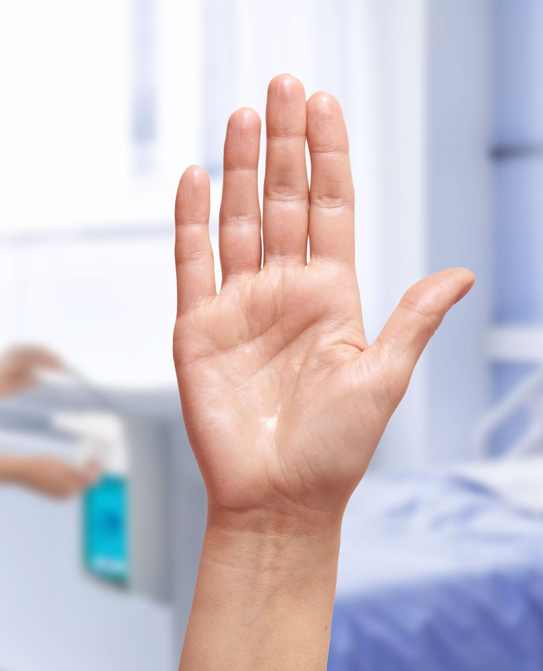

01 | LEARNING OBJECTIVES
Clinical Relevance
Clinical relevance of hand disinfection.
Each year in Europe, there are approximately 3.5 million healthcare-associated infections (HAIs), leading to more than 90,000 deaths.^{[1]}
HAIs most commonly occur in the form of: ^{[2]}
Postoperative wound infection (24%)
Urinary tract infection (23%)
Lower respiratory tract infection (22%)
More than 50% of all nosocomial infections are considered preventable.

Slide 5
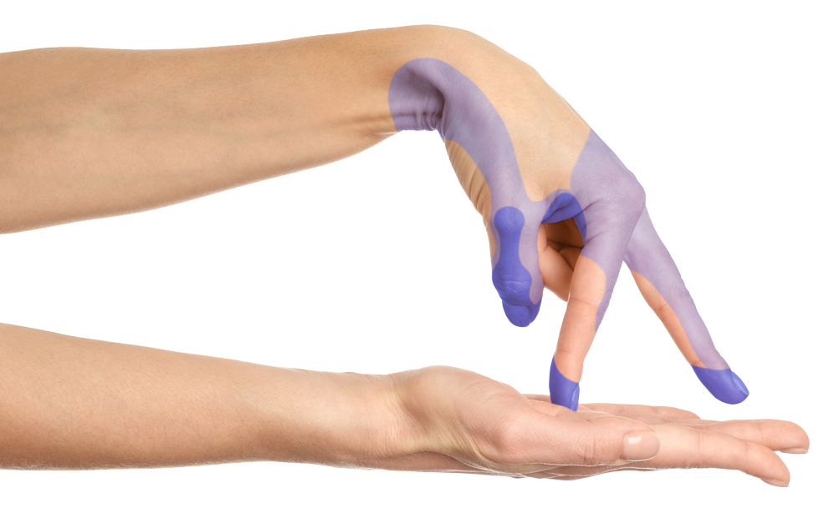
01 | LEARNING OBJECTIVES
Clinical Relevance
Hand disinfection
can save lives.
Up to 90% of all nosocomial infections are transmitted via hands^{[3]} – our most valuable tools when dealing with patients and medical devices.
However, many hand disinfections are...
incomplete (53-93 %) ^{[4-5]}
Especially fingertips, spaces between fingers & thumbs
with insufficient dosage amount (Ø 43 %) ^{[6-7]}
Recommended are, depending on hand size, approx. 3 to 5 ml
completely forgotten (30-80 %) ^{[8-14]}
Observe the "5 Moments"
... This is what we want to change!

Slide 6

01 | LEARNING OBJECTIVES
Sources of Error and Learning Objectives
Sources of Error
Learning Objectives
Dosage amount /excessive dripping
Wetting gaps
Critical areas addressed too late
Damaged skin
Individual dosage amount
Effective rubbing technique
Optimal sequence
Recognizing problem areas

Slide 7
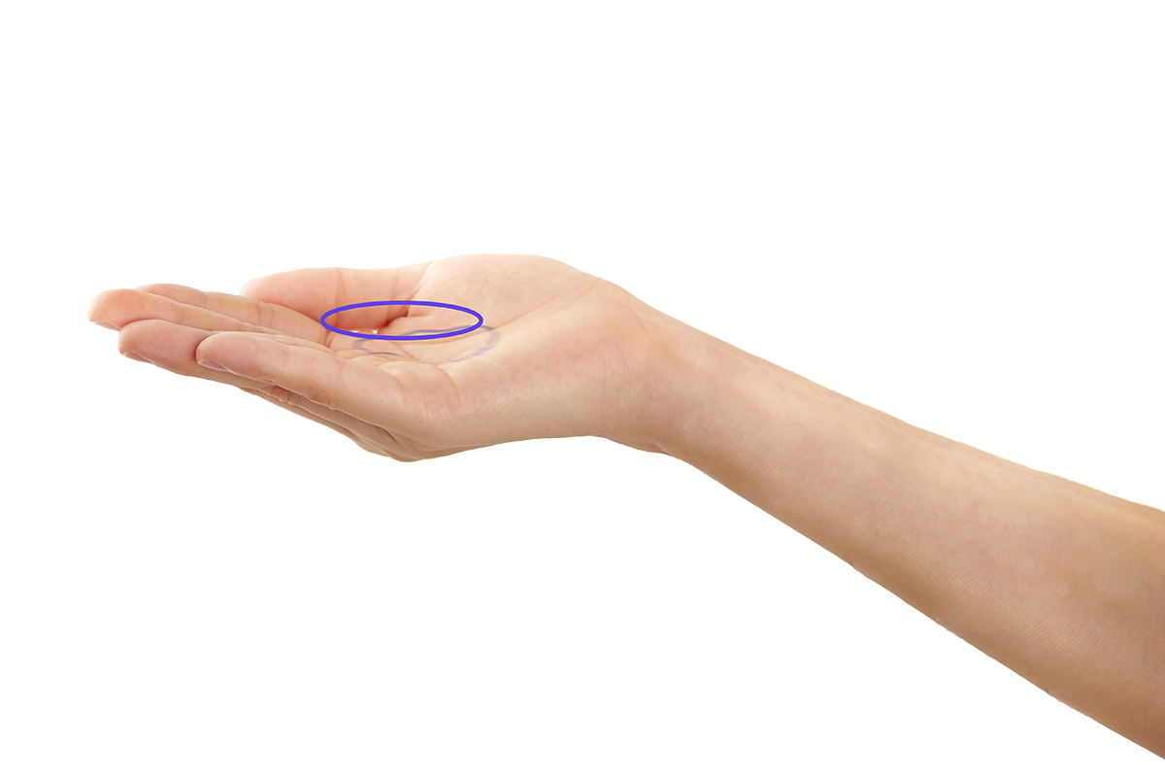
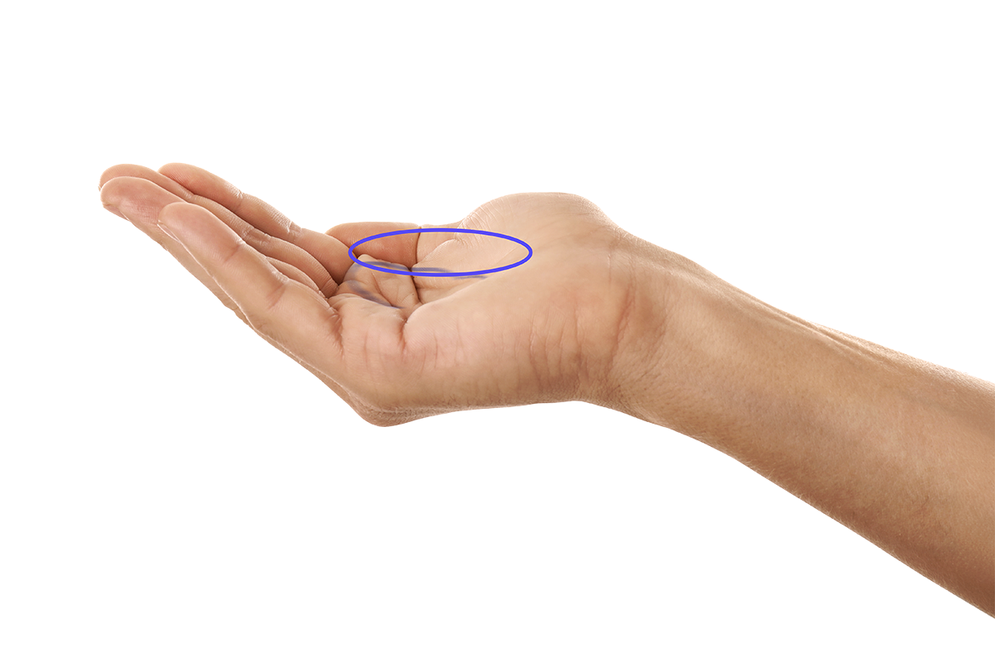
01 | LEARNING OBJECTIVES
Dosage Amount
The Individual Dosage Amount
The correct dosage amount depends on the individual hand size.
It determines the duration of the contact time (time until the alcohol has evaporated). Generally, a contact time of 30 seconds is recommended.
RULE OF THUMB: Completely fill the palm of your hand with liquid. Avoid dripping.
S
XL
2 – 3 ml
4 – 5 ml

Slide 8

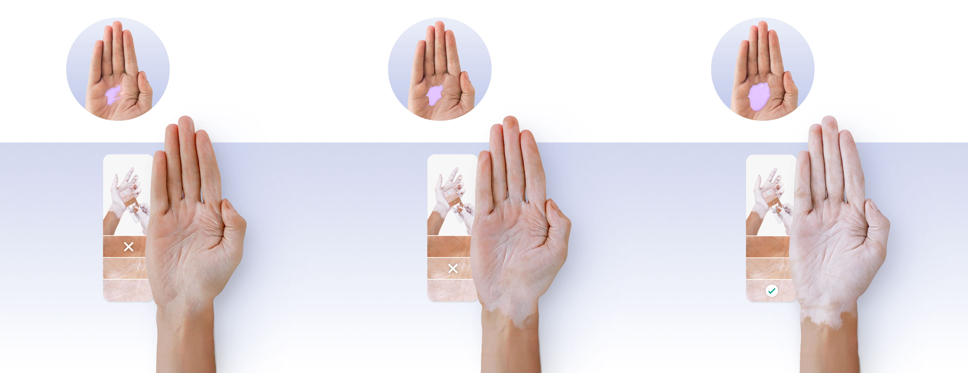
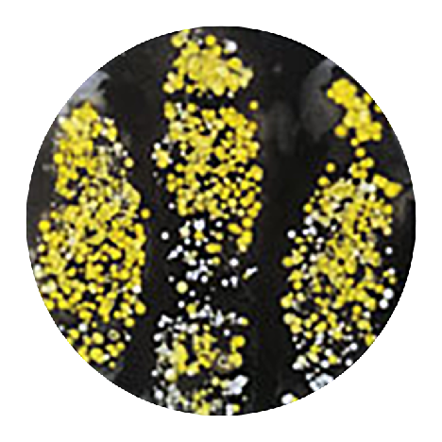
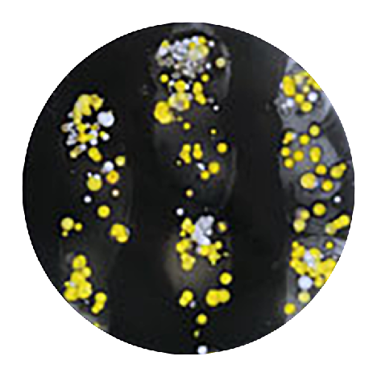
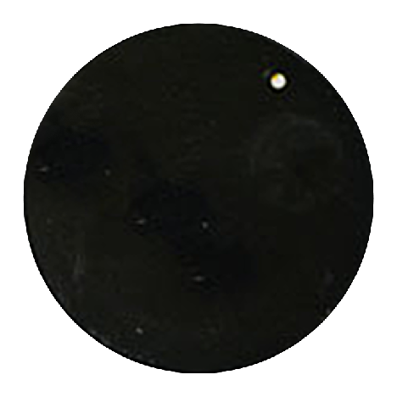

01 | LEARNING OBJECTIVES
Dosage amount
Dosage amount
determines
effectiveness
30 % of required amount
60 % of required amount
100 % of required amount
Declared effectiveness achieved
Declared effectiveness probably not achieved
Declared effectiveness in the colored areas achieved

Slide 9
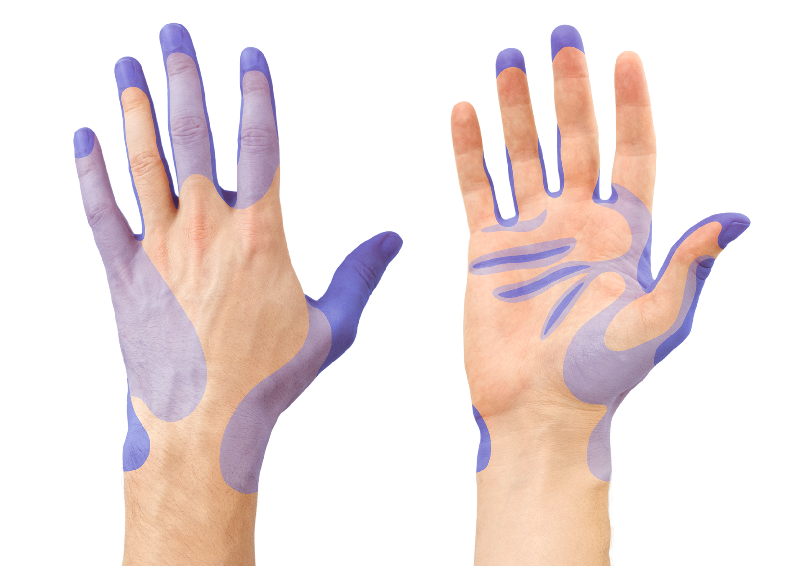


01 | LEARNING OBJECTIVES
Hand Rubbing Technique
Common Wetting Gaps
Wetting gaps are a common problem that we normally don't even notice in everyday life. Especially the fingertips, with which we touch everything, are most frequently forgotten.
RECOMMENDATION: Apply helpful hand movements and follow the correct sequence.
Frequently
forgotten
Very frequently
forgotten

Slide 10
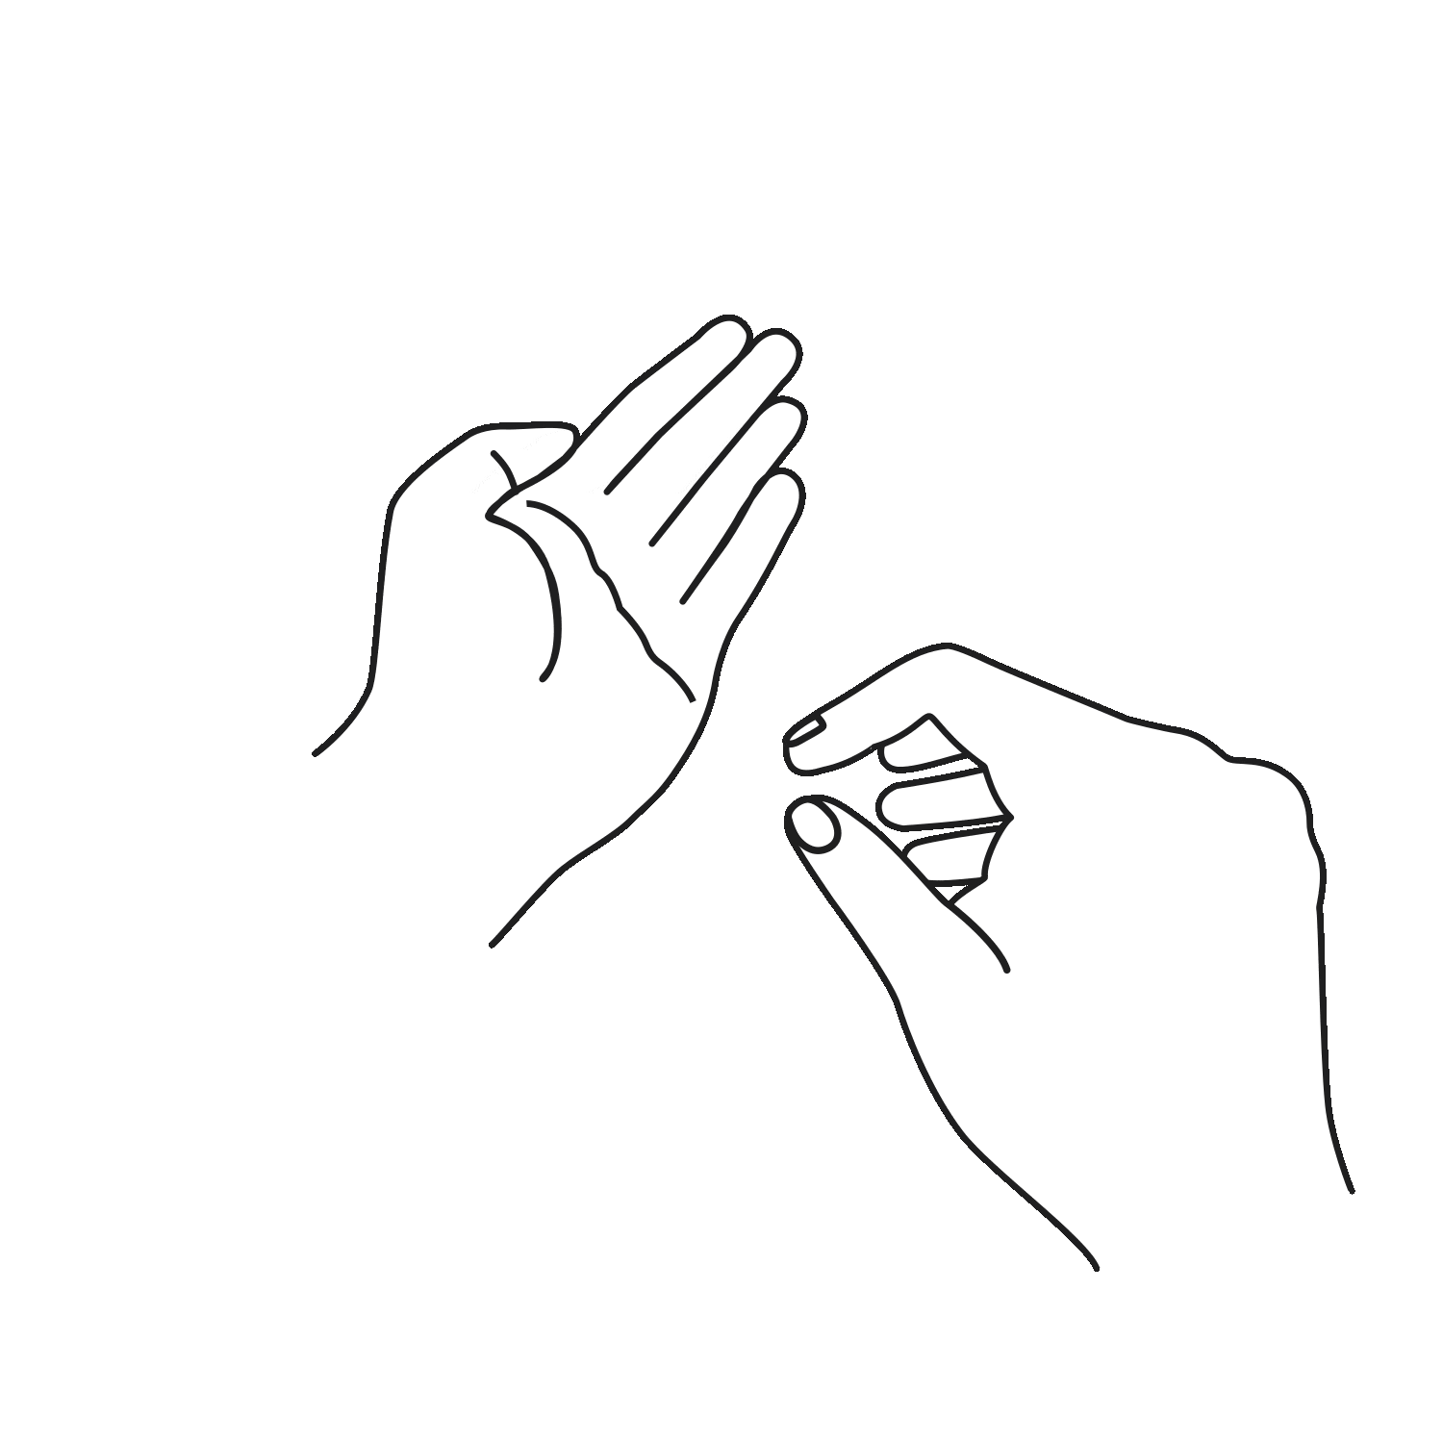
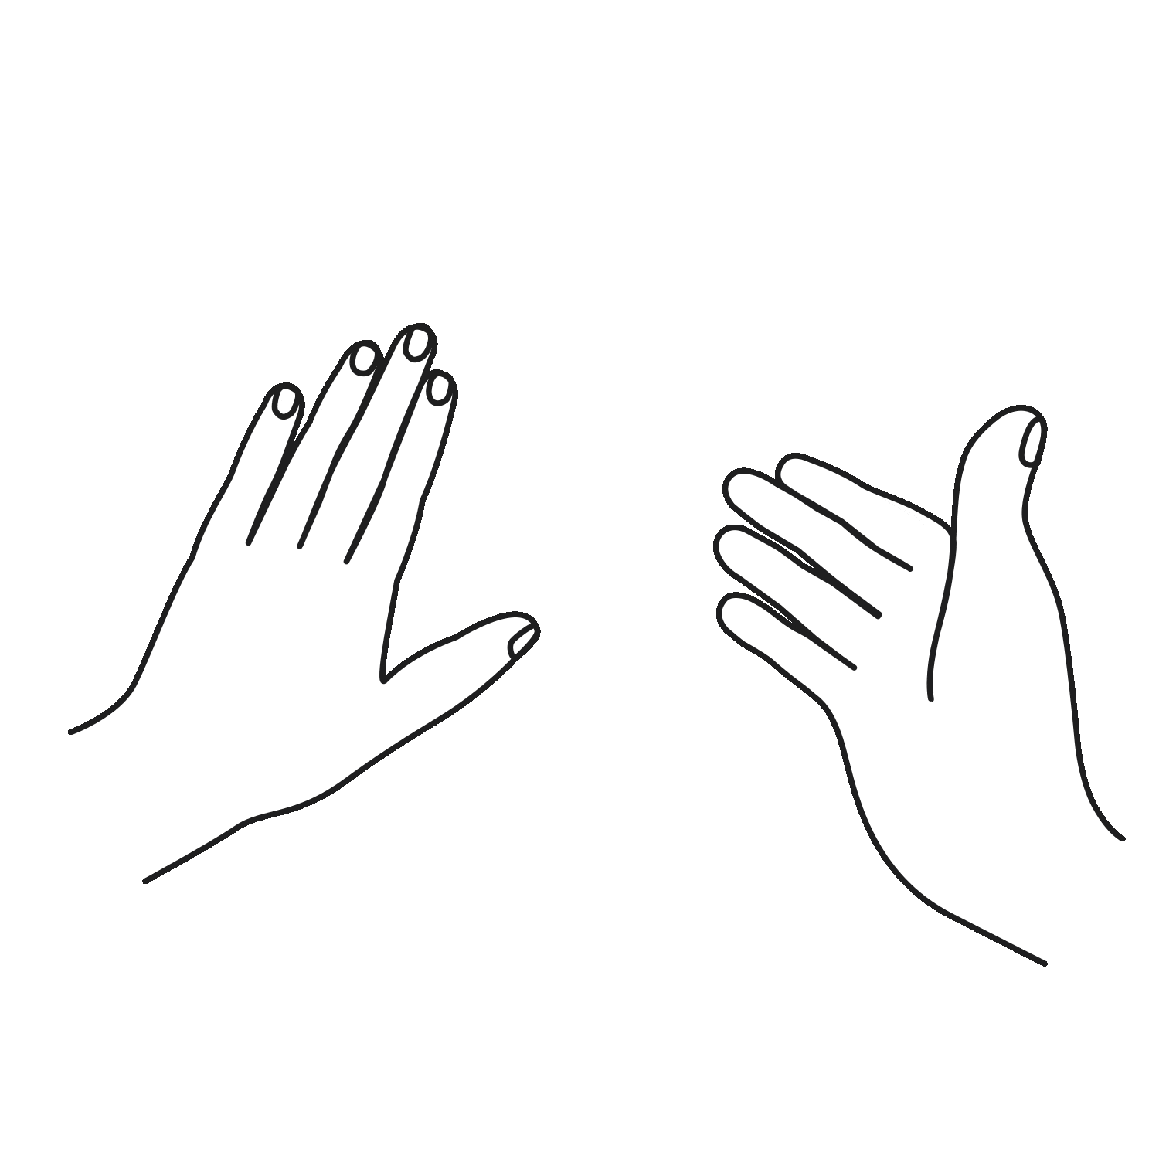
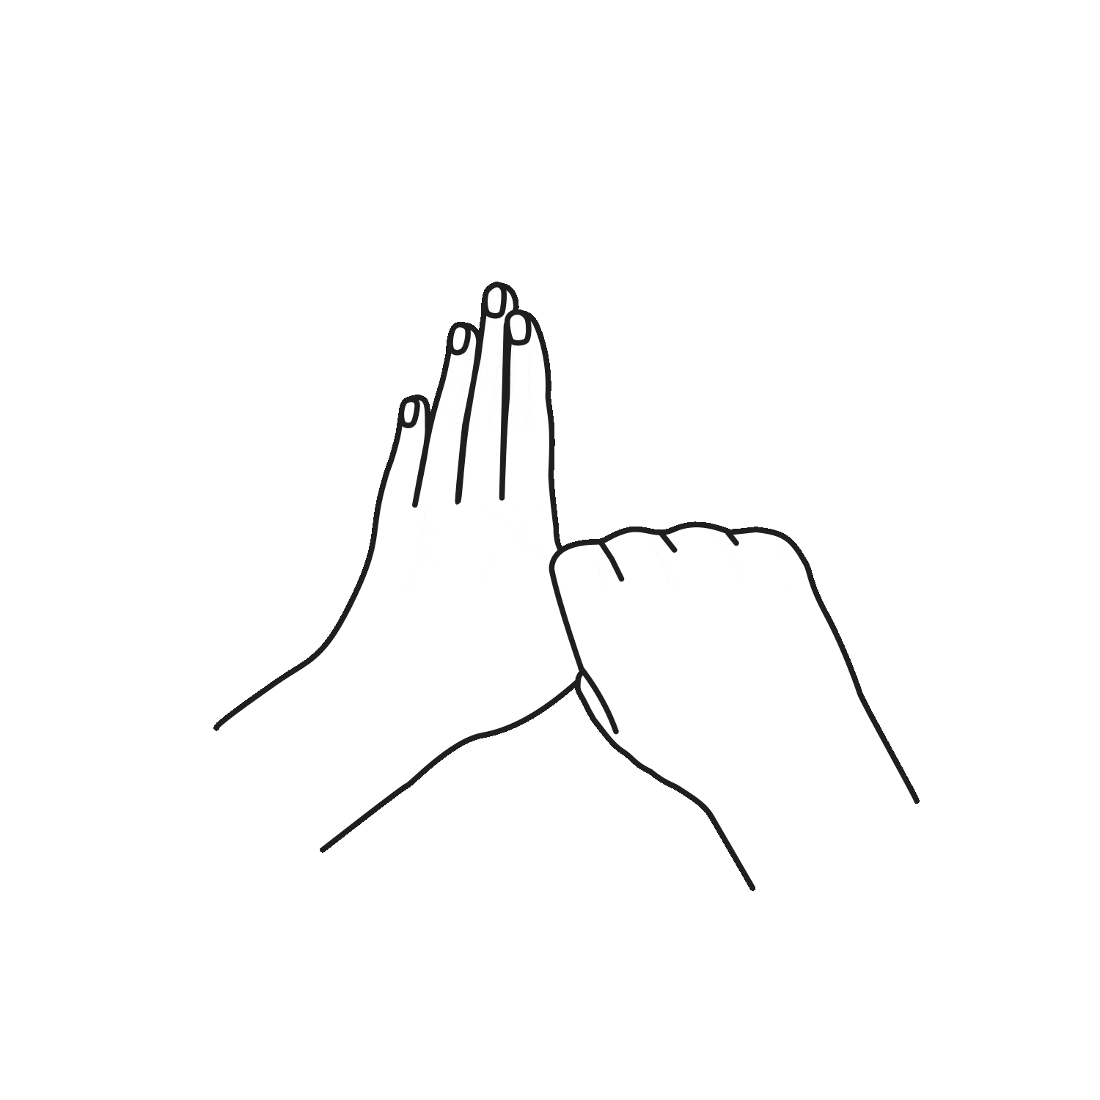
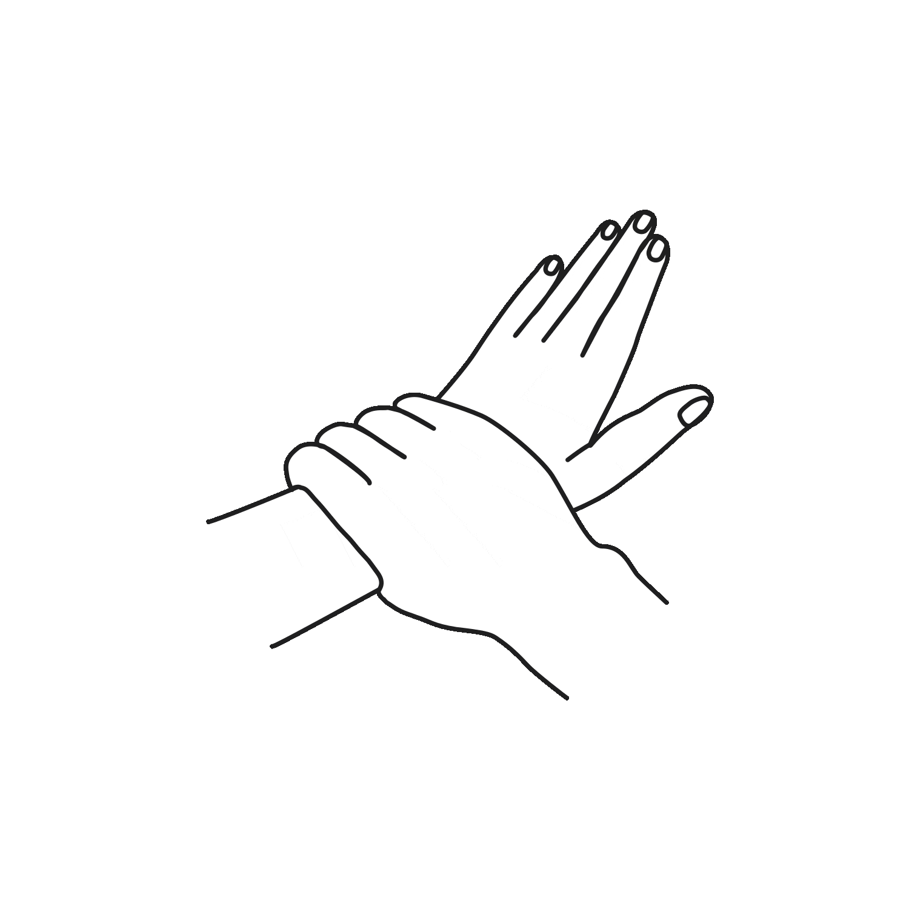
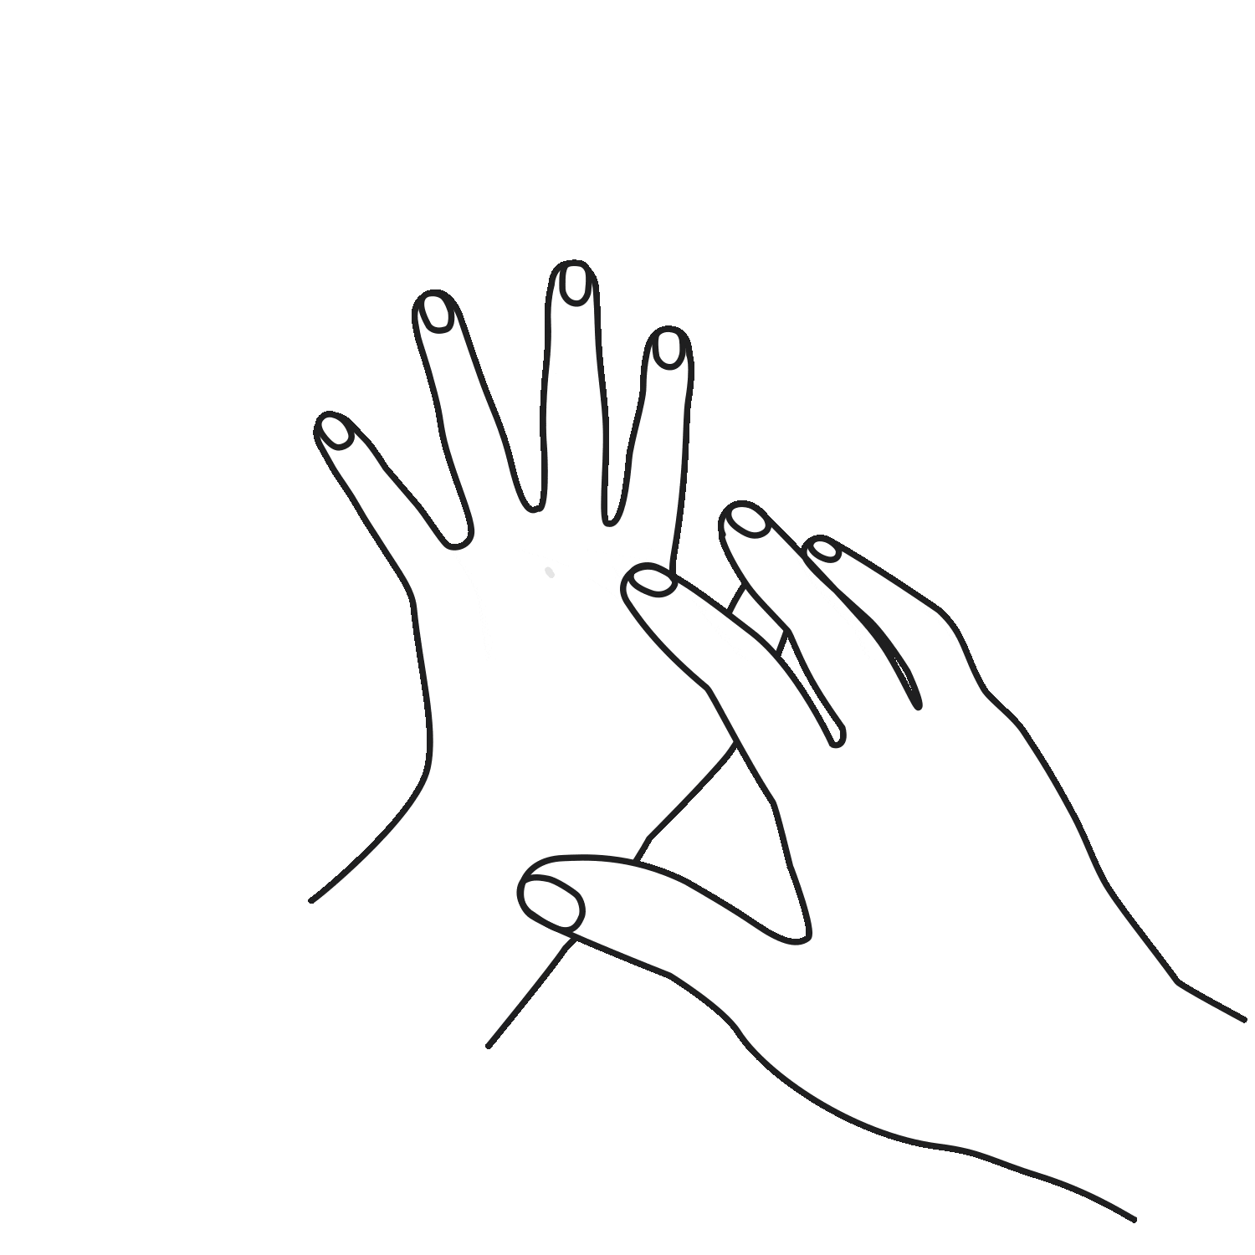
01 | LEARNING OBJECTIVES
Hand Rubbing Technique
Helpful Techniques
These proven techniques are helpful to wet all areas completely and in a timely manner.
Recommendation: Studies show that a self-directed hand rubbing technique developed during training achieves better results than memorized steps.^{[4]} Use these techniques to create your own individual routine.
Fingertips
Back of fingers
Interdigital spaces
Thumbs
Wrists

Slide 11
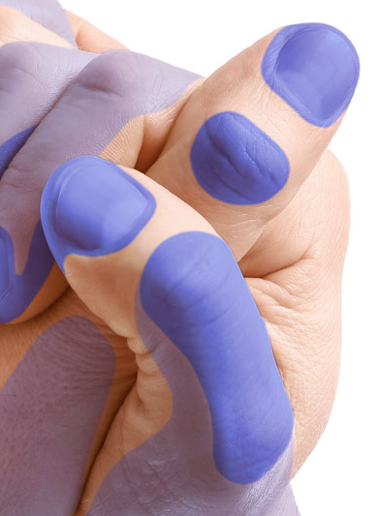
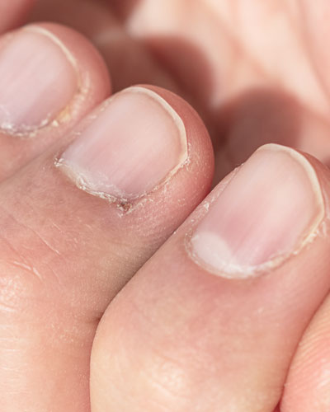
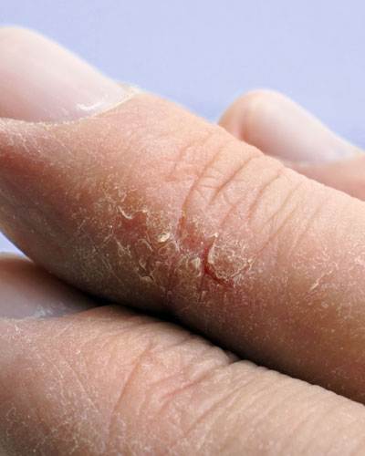
01 | LEARNING OBJECTIVES
Problem Areas
Recognizing Problem Areas
Everyone has their problem areas: right-handed people often forget their right thumb, left-handed people their left, nail folds with deep grooves or dry skin...
RECOMMENDATION: Intact skin is a basic requirement for good hand hygiene. During training, pay attention to personal problem areas to consciously address them – for example, through targeted skin care.
Damaged skin provides a breeding ground for a variety of skin problems and, in addition to germs from the normal skin flora, is also more frequently colonized with potentially pathogenic germs.
Thus, damaged skin not only increases one's own risk of infection but also the risk of transmission to patients.
Wetting gaps
Nail folds
Dry, cracked skin
Notes:
Alle Menschen haben so ihre Problemstellen. Bei mir ist es der rechte Daumen und die Nagelfalz. Den rechten Daumen vergesse ich häufig. Meine Nagelfalz hat tiefe Furchen. Allgemein habe ich sehr trockene Haut, die schwer zu desinfizieren ist. Durch das Training der Händedesinfektion werde ich auf all meine Problemstellen aufmerksam gemacht. Nur wenn ich dieses Bewusstsein habe, kann ich eine Lösung für meine Problemstellen suchen und finden.
Daher: das Erkennen von Problemstellen ist entscheidend.

Slide 12
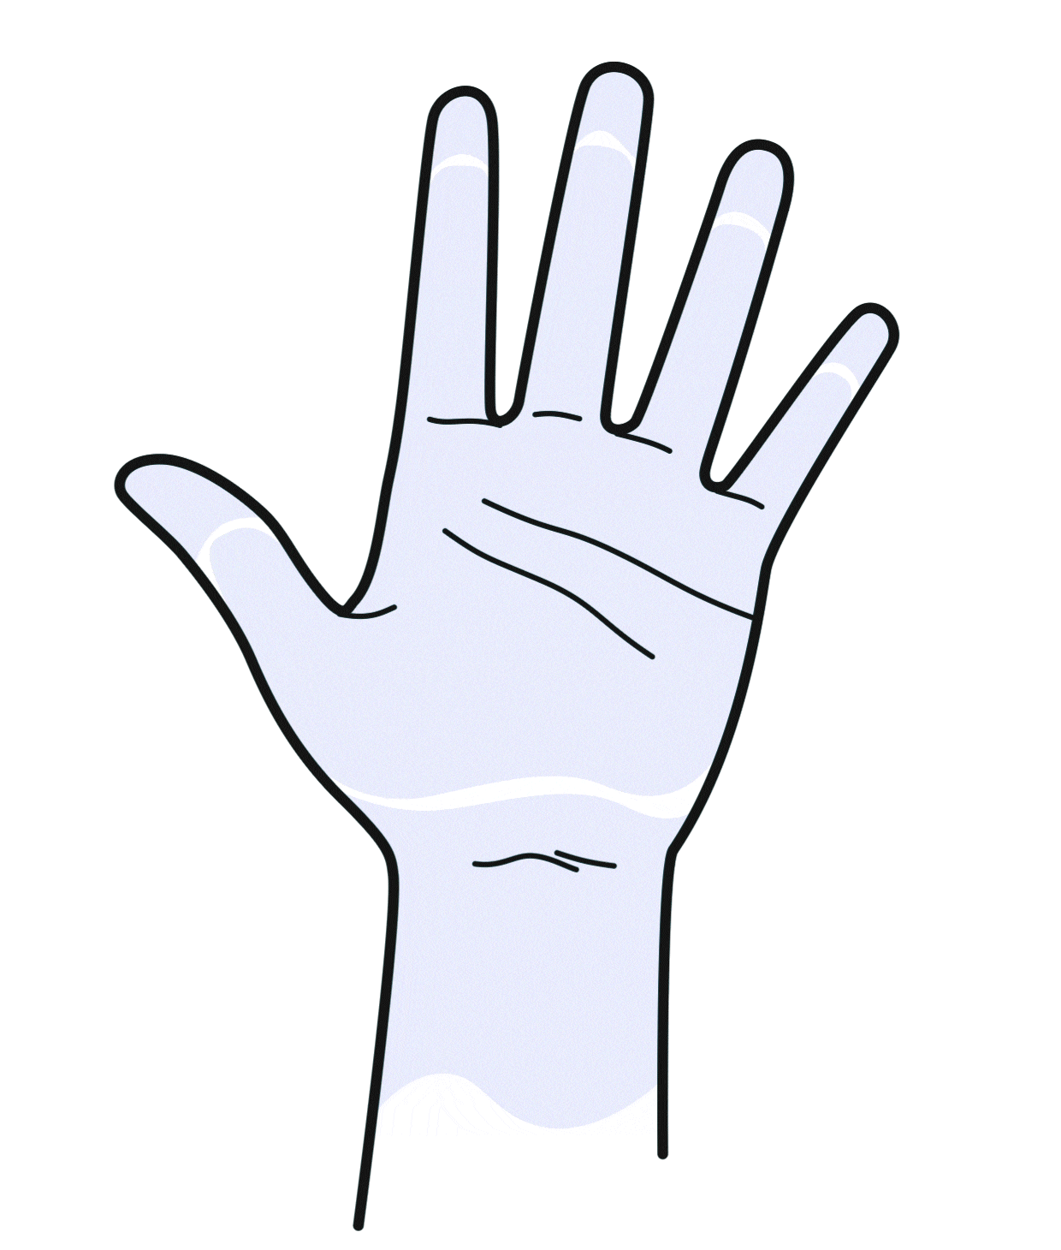
01 | LEARNING OBJECTIVES
Sequence
Optimal Sequence
Always apply disinfectant to dry hands.
Areas with high germ density should be addressed right at the beginning, so the liquid reaches everywhere in time.
1
Germ density on hands ^{[16]}
Under fingernails: 61,370 CFU/cm²
Palm: 850 CFU/cm²
Back of hand: 250 CFU/cm²
Spaces between fingers: 220 CFU/cm²
CFU = Colony-Forming Units
Fingertips and thumbs are not only difficult to disinfect but also areas with the highest germ density.
2
Next, wet fingers, spaces between fingers, palms, and backs of hands.
3
Don't forget the wrists.

Slide 13
When should you disinfect your hands?
5 Moments of Hand Disinfection

Slide 14

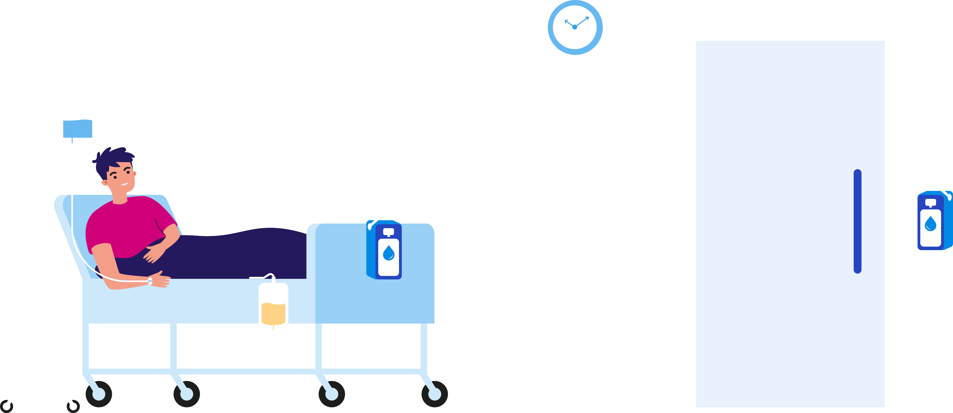

02 | NECESSARY SITUATIONS
The 5 Moments of Hand Disinfection
Direct patient environment
In intensive care units: • Patient bed with infusion pumps/syringe pumps • Ventilation unit • Monitoring display • Associated computer workstation (if located directly at the patient's bedside) • All devices assigned to the patient
On regular wards: • Patient bed with associated bedside table • All personal items contained within
• All devices assigned to the patient
EXTENDED patient environment
All areas of the patient's room beyond those mentioned above.
Based on "My 5 Moments of Hand Hygiene," WHO 2009

Slide 15

02 | NECESSARY SITUATIONS
The 5 Moments of Hand Disinfection
5. After contact with patient surroundings
2. Before an aseptic procedure
1. Before patient contact
4. After patient contact
3. After contact with potentially infectious material
Based on "My 5 Moments of Hand Hygiene," WHO 2009

Slide 16
Roll up your sleeves:
It's time for the practical part!
Training with DesiCoach®

Slide 17

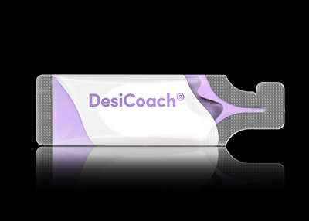
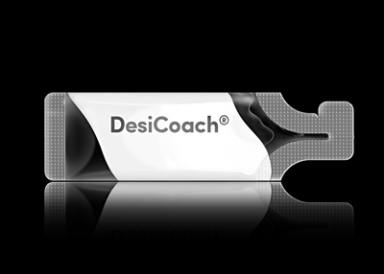



PREPARATION
For the training, we need good lighting, moist wipes, and an easy-to-clean surface.
PART 1
PART 2
Colorizer
Decolorizer
First invisible, then visible.
Insight through decolorization.
Transparent when applied
Coloration after approx. 1 min.
Immediate decolorization
Visualizes every movement
Individual dosage amount
    Correct rubbing technique
    Identifying problem areas
Optimal sequence
LEARNING OBJECTIVES

Slide 18

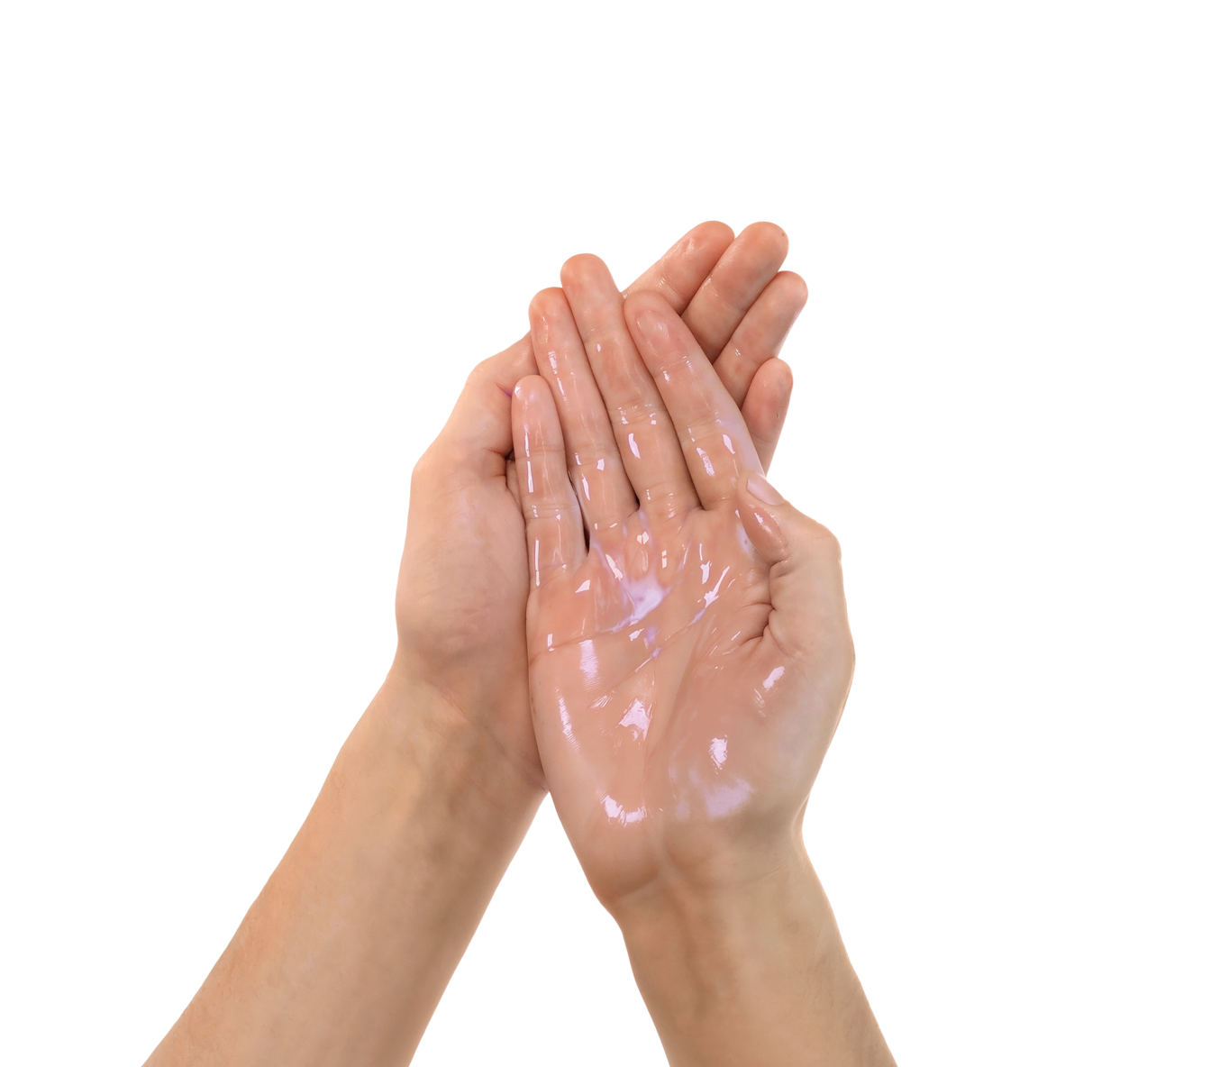

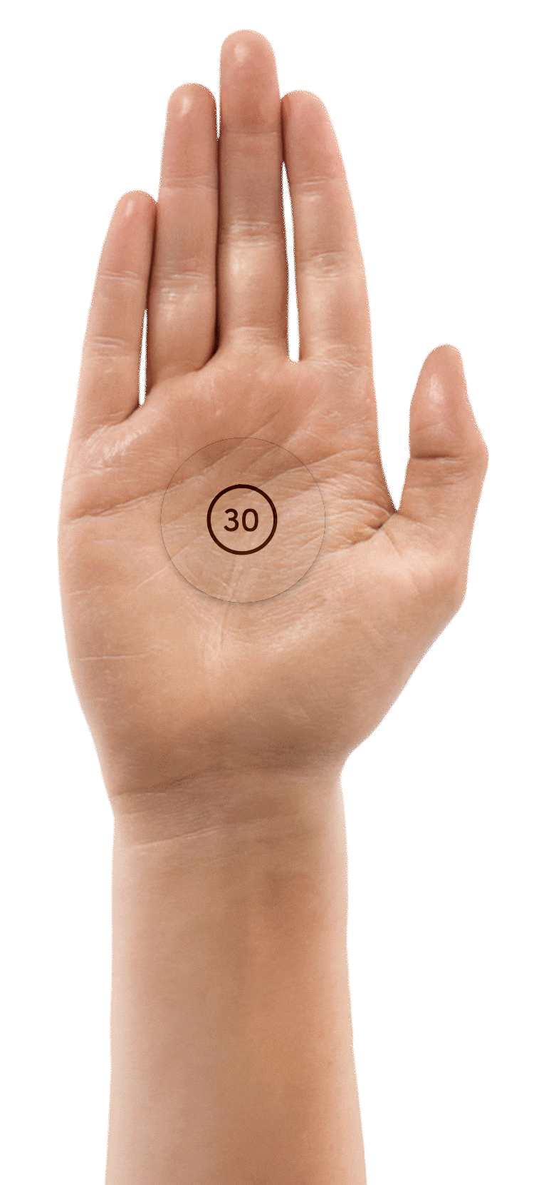
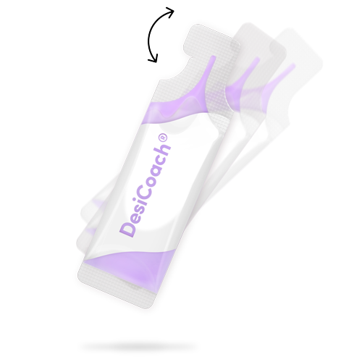
03 | TRAINING
Step
Training with colorizer
TAKE THE COLORIZER
First, shake the colorizer like a
cocktail shaker (to dissolve sediment)
... then open it.
DOSAGE
Fill your entire palm with the colorizer. Depending on the size of your hand,
you'll need more or less liquid.
RUB IN
Rub your hands thoroughly.
Then wait 30 to 60 seconds until
the coloration becomes visible.

Slide 19

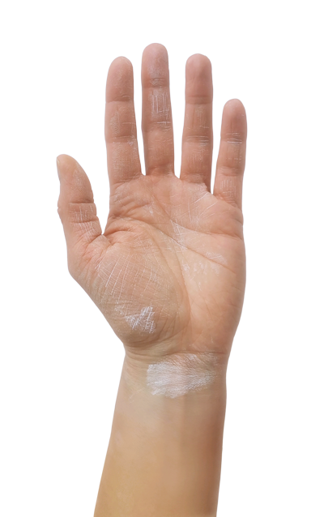
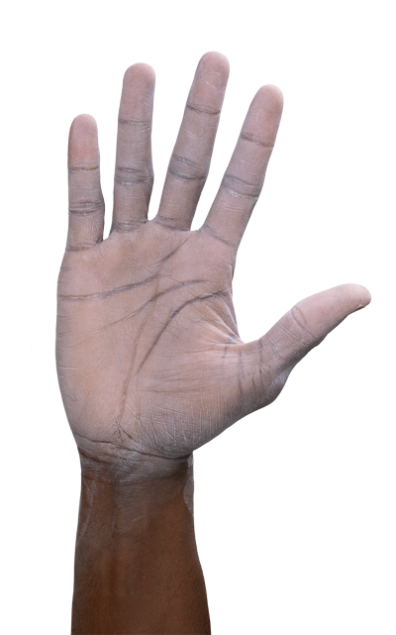
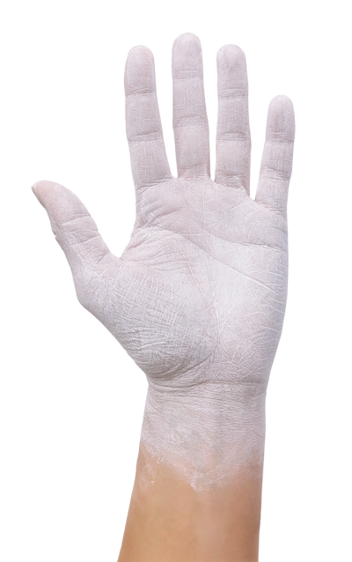
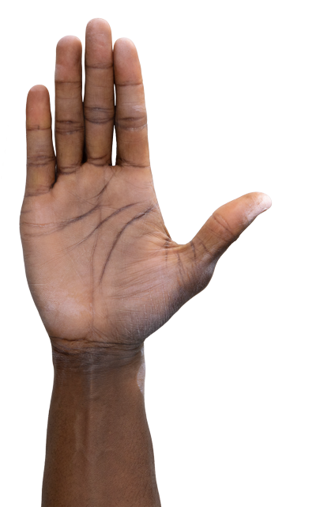
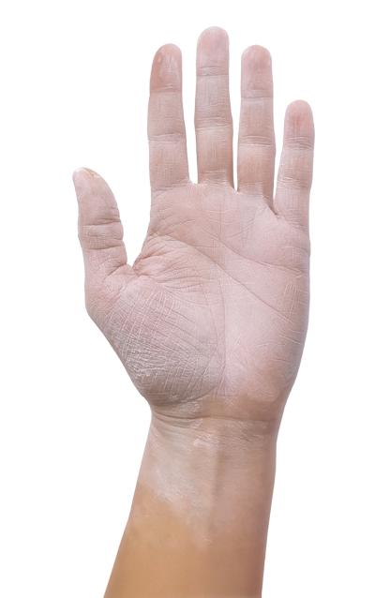
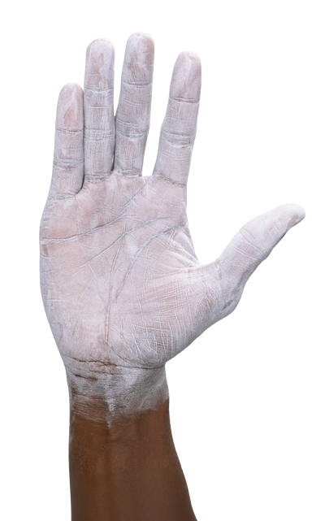
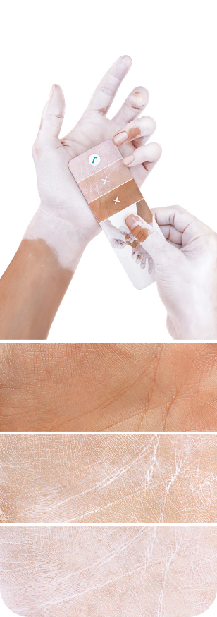
03 | TRAINING
Step
Check: Dosage Amount
What germ reduction have you achieved?
Compare the coloring of your palm with the color chart.
Large areas are uncolored.
If possible, wash your hands and repeat Step 1.
The dosage amount was too low. Or check if too much dripped off during application.
Very good!
The dosage amount was sufficient.

Slide 20
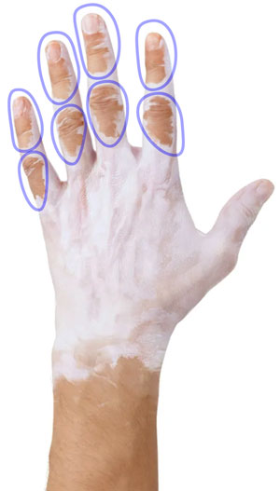
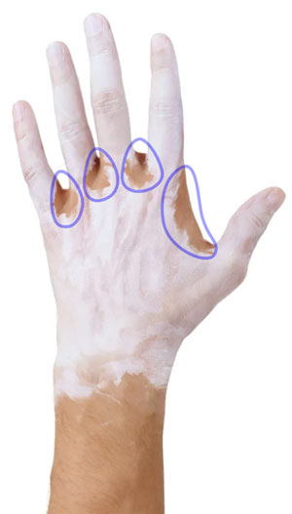
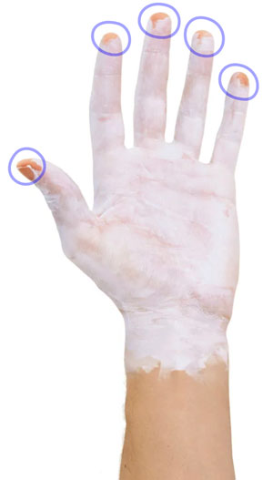
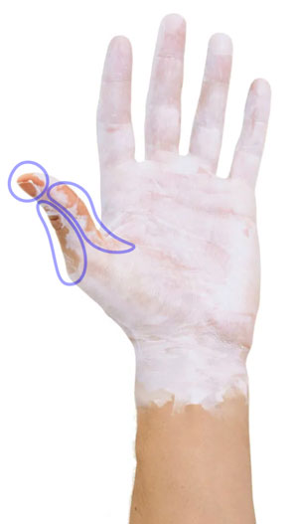
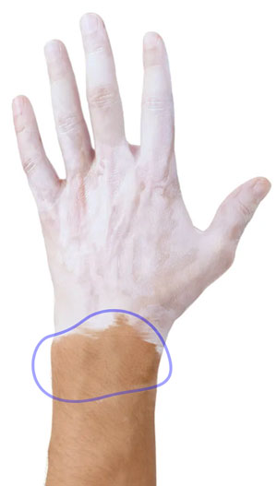
03 | TRAINING
Step
Check: Wetting
Which areas are not colored?
Use these helpful techniques
to close the gaps right away when decolorizing.

Slide 21

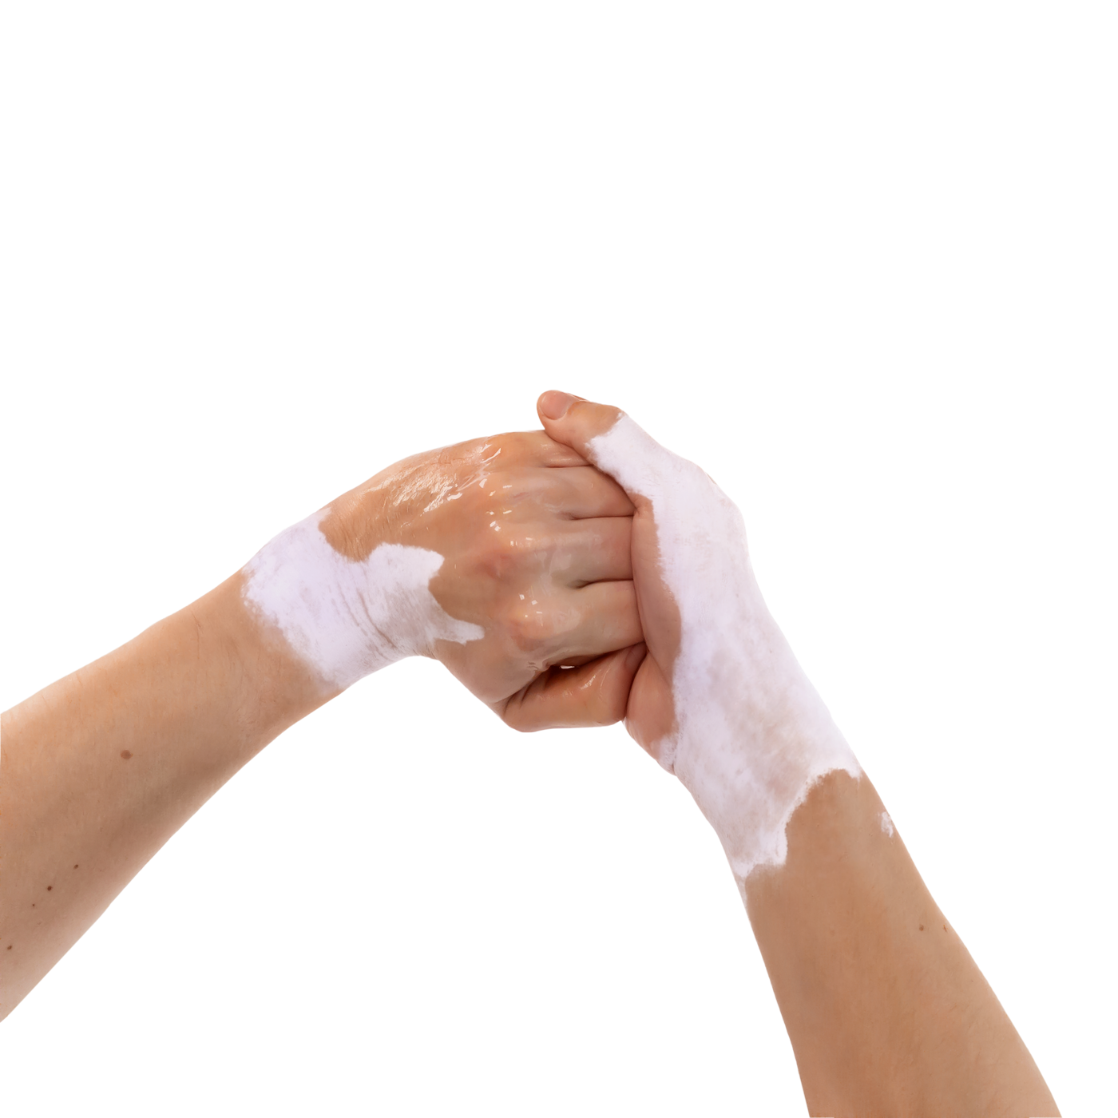
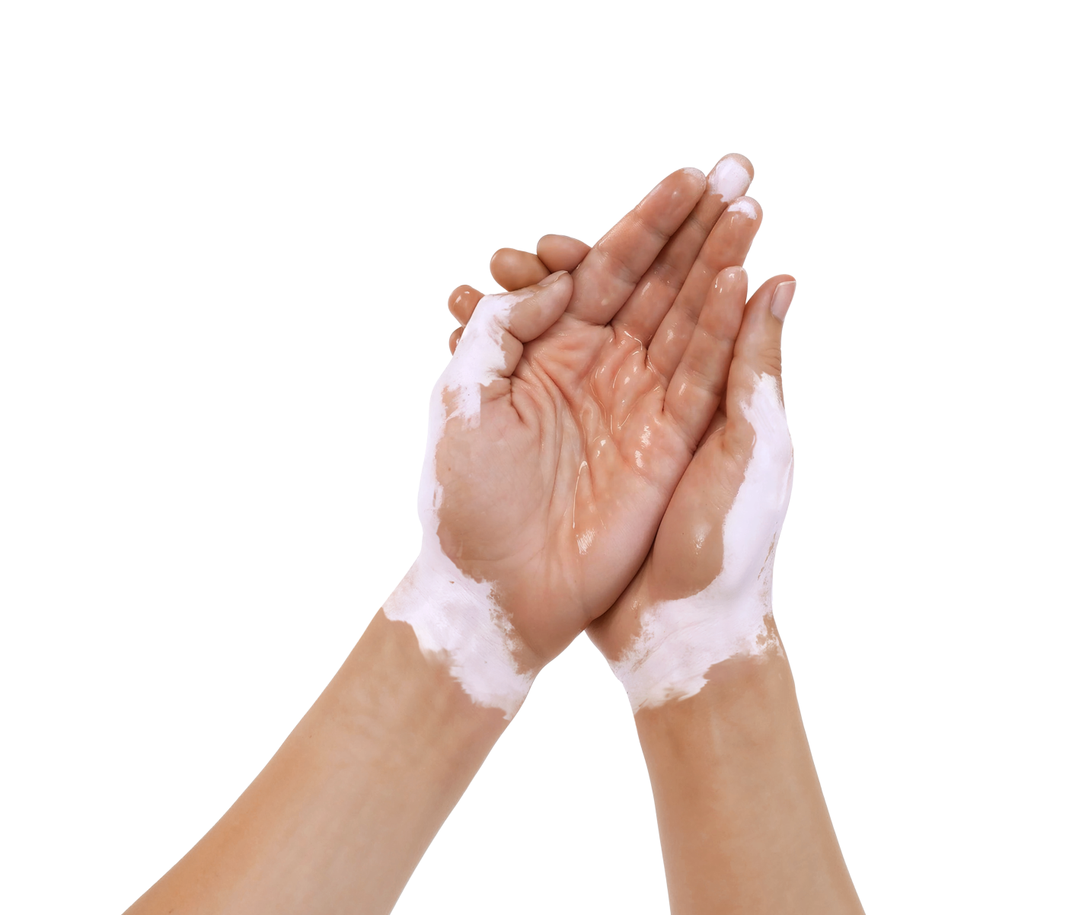
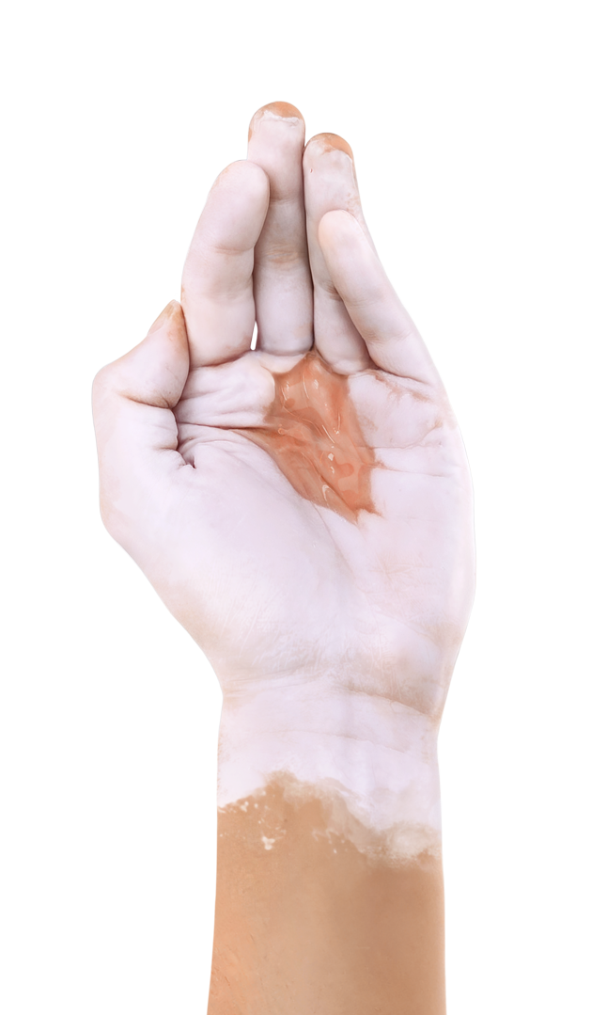
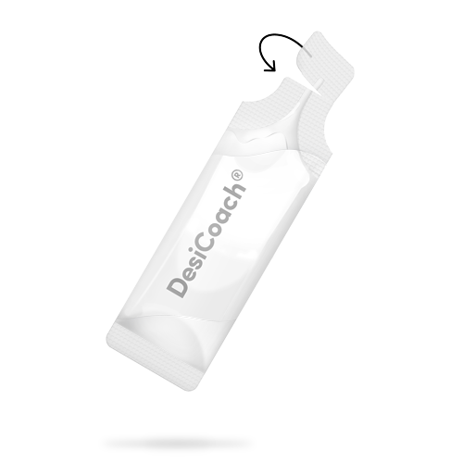
03 | TRAINING
Step
Training with decolorizer
TAKE THE DECOLORIZER
... and open it.
DOSE AND RUB IN
Fill your cupped hand with the decolorizer. As you rub it in, every hand movement will immediately become visible.
OPTIMIZE TECHNIQUE
Look closely: Which hand movements wet your hands the fastest?

Slide 22

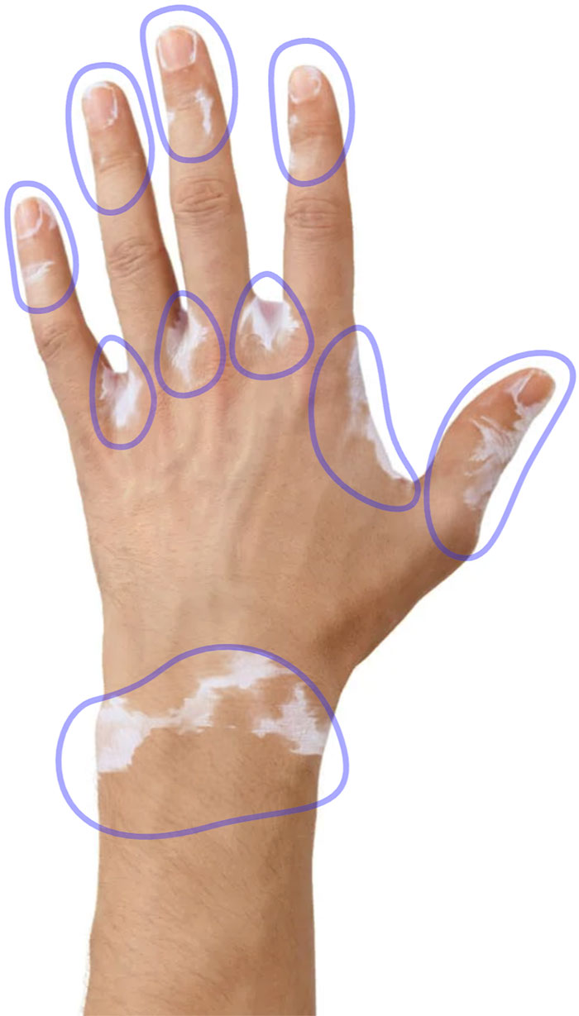
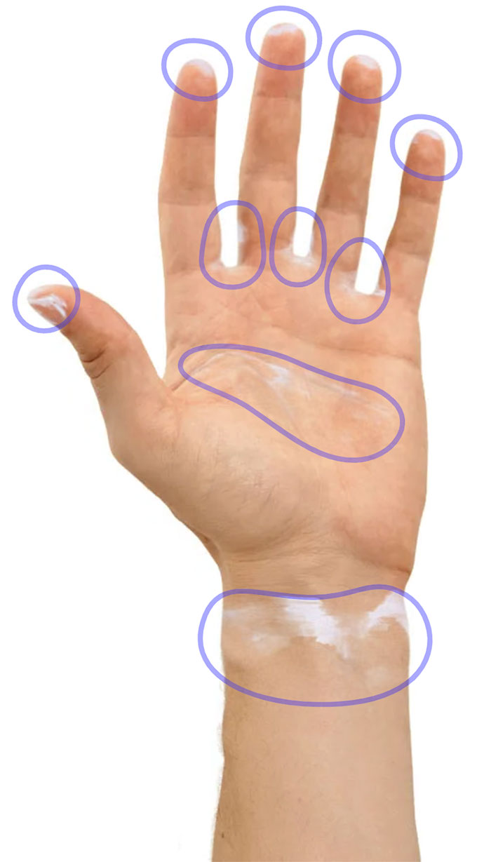
03 | TRAINING
Step
Check: Wetting
and Sequence
Are there still color residues on your hands?
Analyze your hand movements and their sequence. Disinfect skin areas with high
germ density right at the beginning.

Slide 23
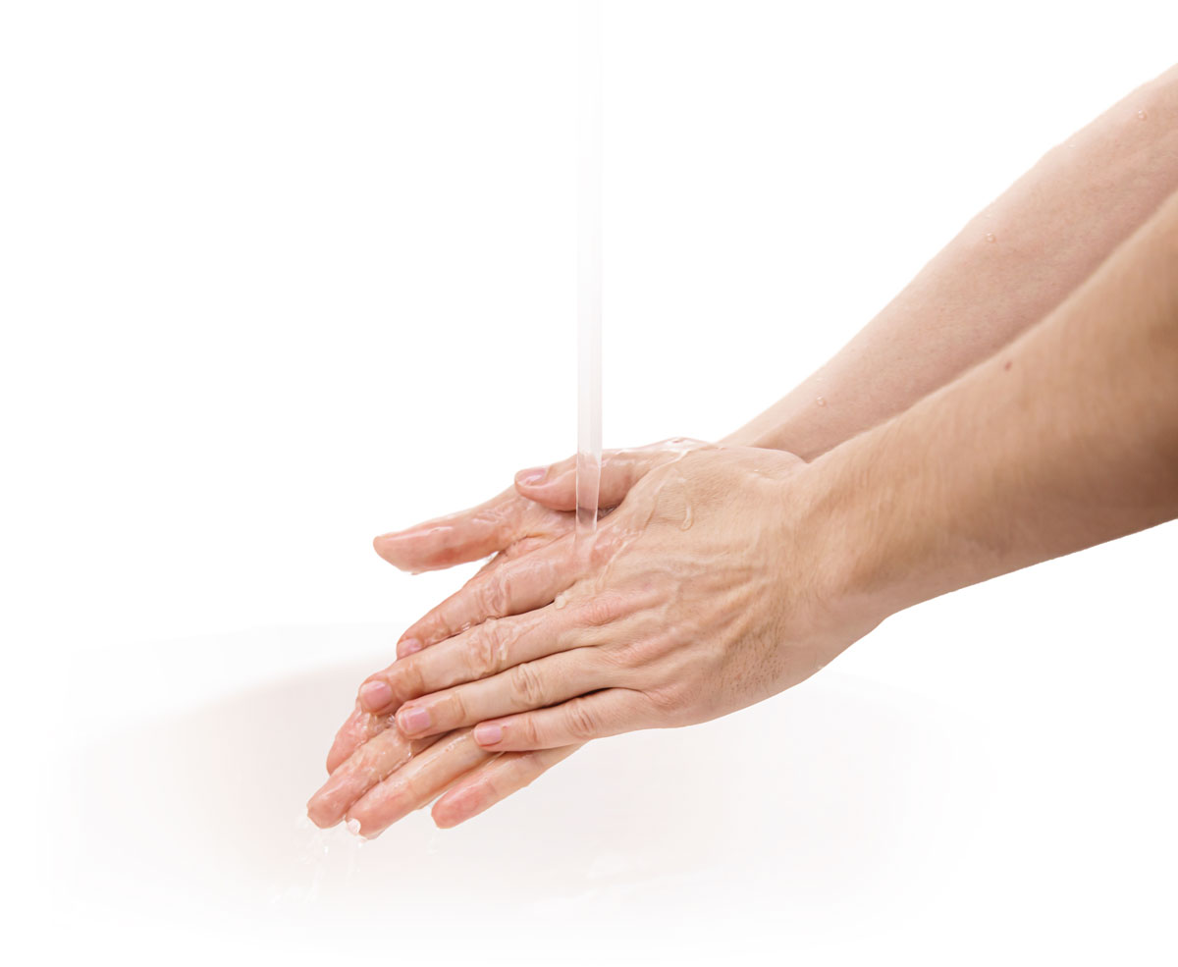

03 | TRAINING
Repeat or end
REPEAT TRAINING
If you've noticed critical errors, you should repeat the training immediately. Wash your hands beforehand so that the Colorizer becomes clearly visible again.
END TRAINING
If you'd like, you can wash your hands and remove any remaining color at the end of the training.
OR

Slide 24
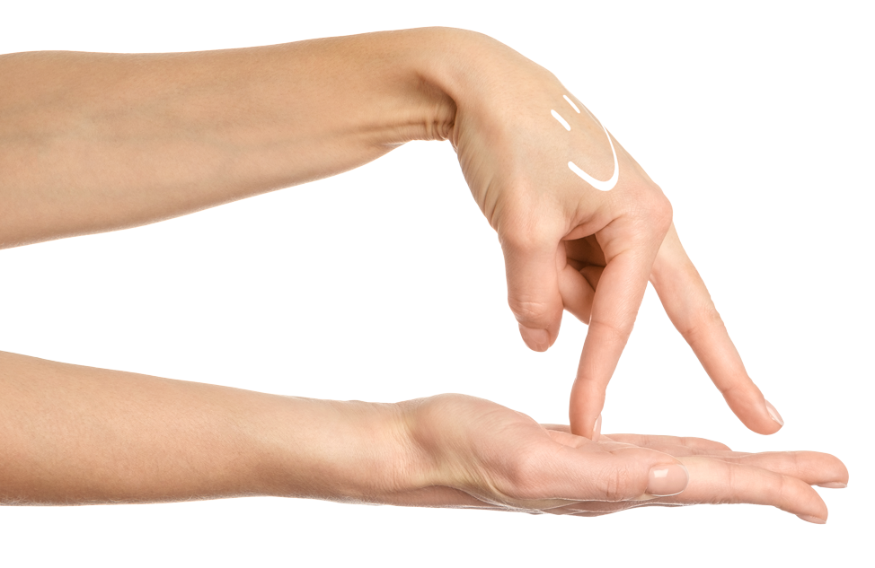



Thank you and stay healthy!
Hygiene Team
Name Contact Person
Department
01234 – 5678 9
e-mail@adresse.de

Slide 25


Hand hygiene:
it's also an art.

Slide 26
Sources
European Centre for Disease Prevention and Control (ECDC). Healthcare-associated infections: Accessed 3 Feb. 2025, from: https://www.ecdc.europa.eu/en/healthcare-associated-infections.
Oesterlee, U., Holt, S.K., Schneitler, S., Randerath, W.; Nosocomial Pneumonia. In: Schneider, P., Kruschewski, M., Buhr, H. (eds) Thoracic Surgery for General and Visceral Surgeons. Springer, Berlin, Heidelberg., 2018, https://doi.org/10.1007/978-3-662-48710-5_24.
"Hand Hygiene in Facilities of Healthcare." Commission for Hospital Hygiene and Infection Prevention at the Robert Koch-Institute. Springer, Berlin, Heidelberg., 2016, Federal Health Gazette 59:1189–1220.
Kampf G, et al. "Influence of rub-in technique on required application time and hand coverage in hygienic hand disinfection." BMC Infect Dis. 2008 ; 8:149.
Taylor L J, "An evaluation of handwashing techniques."
Nurs Times. 1978; 74(2):54-5.
McGuckin M, et al. "Hand Hygiene Compliance Rates in the United States—A One-Year Multicenter Collaboration Using Product/Volume Usage Measurement and Feedback." American Journal of Medical Quality. 2009;24(3):205-213.
Li X, et al. "Experimental study on disinfection effect of different dose of rapid hand disinfectant." Int J Nurs Sci. 2014;1(2):212–214.
Eckmanns T, et al. "Compliance with antiseptic hand rub use in intensive care units: the Hawthorne effect." Infect Control Hosp Epidemiol. 2006;27(9):931–934.
Hagel S, et al. "Quantifying the Hawthorne effect in hand hygiene compliance through comparing direct observation with automated hand hygiene monitoring." Infect Control Hosp Epidemiol. 2015;36(8):957–962
Marra AR, et al. "A multicenter study using positive deviance for improving hand hygiene compliance." Am J Infect Control. 2013;41(11):984–988.
Karaaslan et al. "Compliance of healthcare workers with hand hygiene practices in neonatal and pediatric intensive care units: overt observation." Interdiscip Perspect Infect Dis. 2014;2014:306478.
Scheithauer S, Lemmon SW. "How can compliance with hand hygiene be improved in specialized areas of a university hospital?" J Hosp Infect. 2013 Feb;83(S1):S17–S22.
Eckmanns T, et al. "Compliance with hand disinfection in intensive care units." Dtsch Med Wochenschr 2001;126(25-26):745–749.
Wendt C, et al. "Differences in hand hygiene behavior related to the contamination risk of healthcare activities in different groups of healthcare workers." Infect Control Hosp Epidemiol. 2004;25(3):203–206.
"6. Hand Hygiene Necessity and Burden". Health Portal. Accessed 3 Feb. 2025, from: https://www.gesundheitsdienstportal.de/files/Händehygiene-Notwendigkeit-und-Belast1.pdf (04/2007).
McGinley KJ, et al. "Composition and Density of Microflora in the Subungual Space of the Hand." J Clin Microbiol 1988;26(5):950–953.

